Slide 1
Clinical Trial Simulations Case Study – In vitro-In vivo translation of efficacy of compounds for the treatment of Chagas disease
Salvatore D’Agate
Clinical Pharmacology & Therapeutics Group, University College London, London, UK

Slide 2
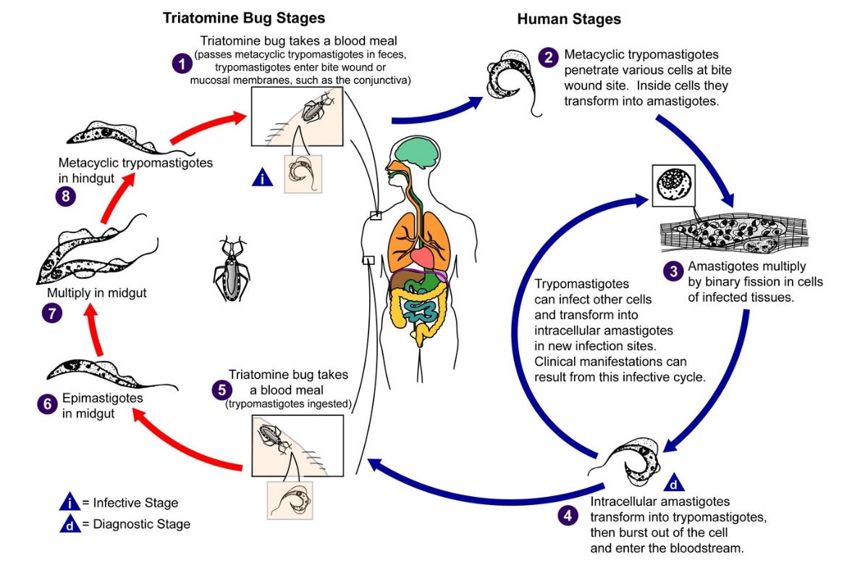
Trypanosoma cruzi
Trypanosoma Cruzi life cycle summarised (CDC. CDC - DPDx - Trypanosomiasis, American. In: DPDx.).

Slide 3
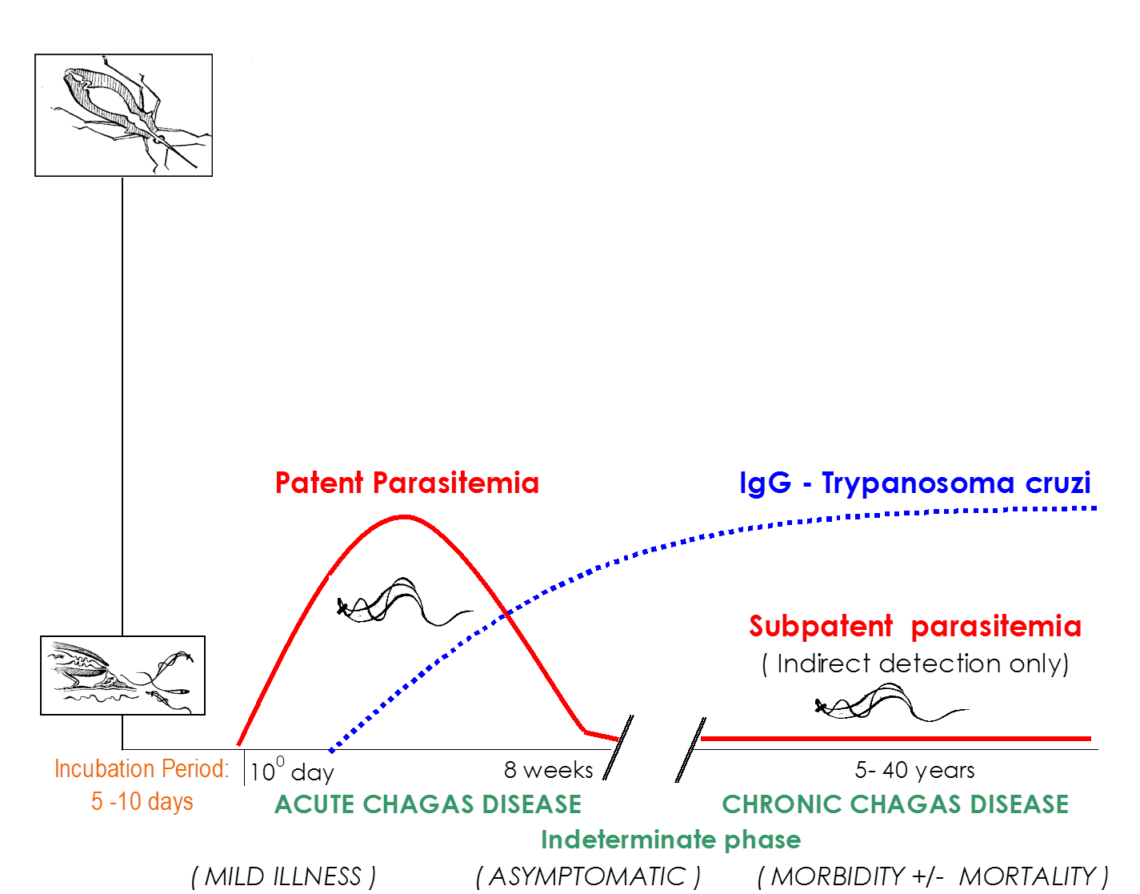
Chagas Disease
Fever
Headache
Anorexia
Weakness
Nausea
Vomiting
Diarrhoea Chagoma
Romaña’s sign
Drug | Age group | Dosage and duration
Benznidazole | < 12 years | 5-7.5 mg/kg/day p.o. b.i.d. for 60 days
 | 12 years or older | 5-7 mg/kg/day p.o. b.i.d. for 60 days
Nifurtimox | ≤ 10 years | 15-20 mg/kg/day p.o. t.i.d./q.i.d. for 90 days
 | 11-16 years | 12.5-15 mg/kg/day p.o. t.i.d./q.i.d. for 90 days
 | 17 years or older | 8-10 mg/kg/day p.o. t.i.d./q.i.d. for 90 days
Organ failure Megaoesophagus Megacolon
Cardiac arrhythmia
Death
Efficacy
Courtesy of Dr Patricia Paredes, Guadalajara, Jal., Mexico.
Notes:
It’s an acute model, animation (acute vs chronic)

Slide 4
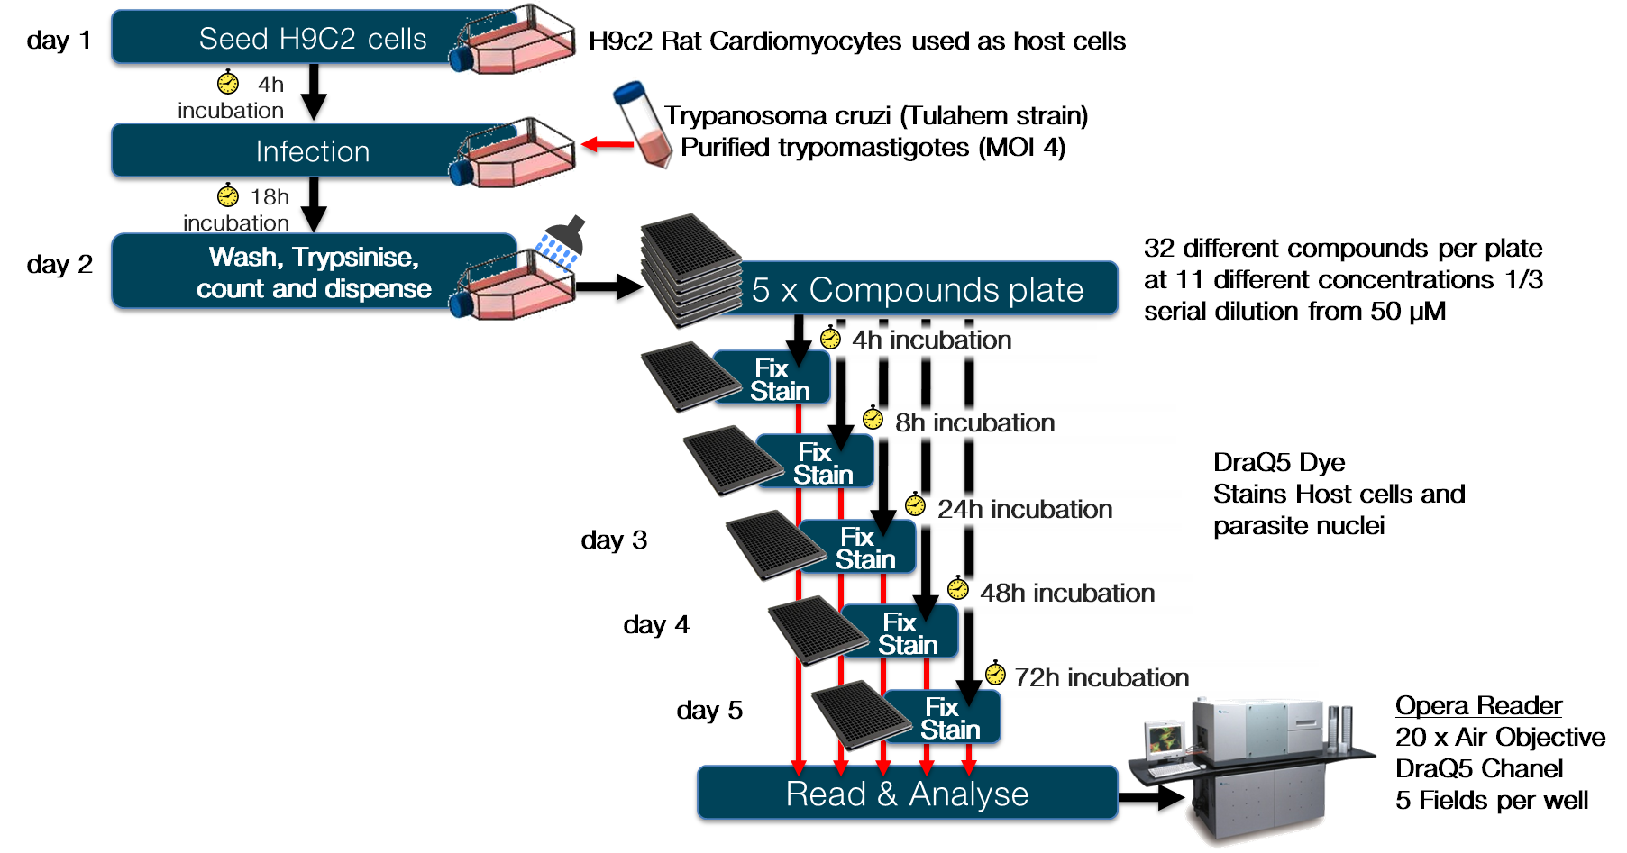
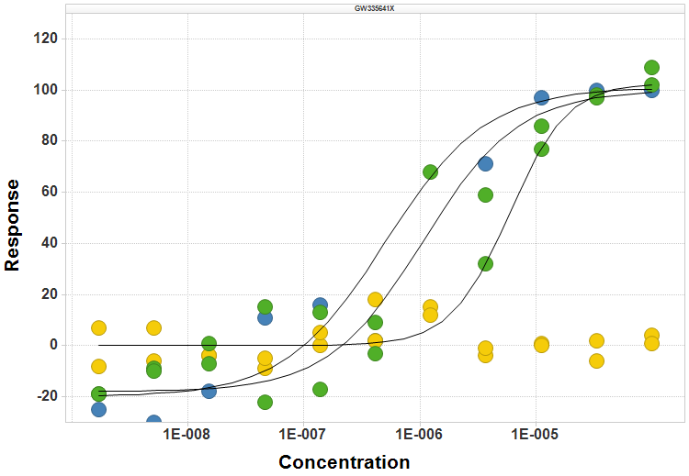
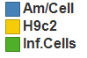
Materials - experimental protocol[1]
[µM]
+ 2 controls
1. Alonso-Padilla et al. PLoS neglected tropical diseases 2015; 9: e0003493.

Slide 5
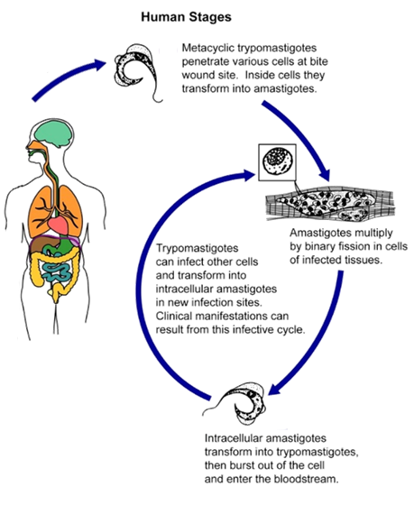
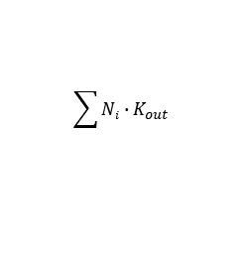
Methods – Protozoa dynamics
H9c2
K_{in}
Trypomastigotes
(TR)
K_{death}
Amastigotes
(AM)
K_{reinf}
$$\sum{Ni}∙K_{out}$$
TR∙K_{reinf}
N₀
K_{out}
iH9c2
N₁
N₄
K_{out}
K_{out}
N_{i}
K₂
S₁
S_{i}
S₄
K₁
K₁
Intracellular parasite growth

Slide 6
Methods - final model
H9c2
K_{in}
E_{Kin}
Trypomastigotes
(TR)
K_{death}
Amastigotes
(AM)
T_{delay}
K_{reinf}
E_{Kdeath}
T_{delay}
$$\sum{Ni}∙K_{out}$$
TR∙K_{reinf}
N₀
K_{out}
iH9c2
N₁
N₄
E_{Kout}
K_{out}
N_{i}
K_{out}
T_{delay}
E_{Kout}
E_{Kout}
K₂
T_{delay}
T_{delay}
S₁
S_{i}
S₄
E_{K1}
K₁
K₁
T_{delay}
E_{K1}
E_{K1}
T_{delay}
T_{delay}
Intracellular parasite growth
$E=1−\frac{I_{max}∙C\left(t\right)}{{IC}_{50}+C\left(t\right)}∙D$ or $E=\frac{E_{max}∙C(t)}{{EC}_{50}+C(t)}∙D$ and $D=\frac{t}{T_{delay}+t}$

Slide 7
Drug-specific parameters
$E=1−\frac{I_{max}∙C\left(t\right)}{{IC}_{50}+C\left(t\right)}∙D$ or $E=\frac{E_{max}∙C(t)}{{EC}_{50}+C(t)}∙D$ and $D=\frac{t}{T_{delay}+t}$
IC_{50K1} inhibitory effect on the parasite replication rate
EC_{50KD} direct effect on the death rate of the parasite
IC_{50KIN} inhibitory effect on the host cells growth rate
IC_{50KOUT} inhibitory effect on the premature lysis of host cells

Slide 8
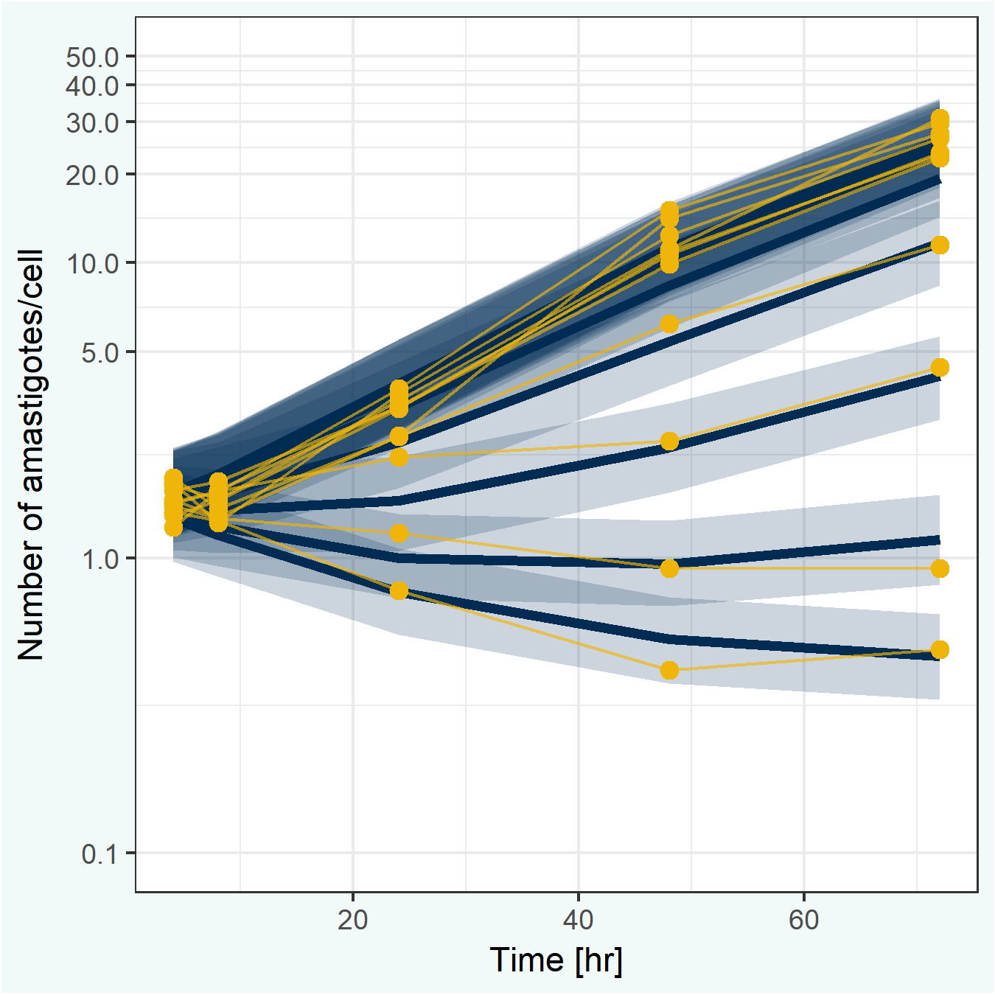
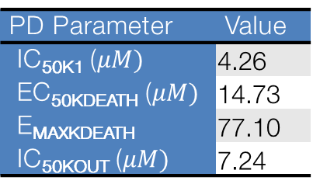
Benznidazole PK/PD parameters
PD Parameter | Value
IC_{50K1} ($μM)$ | 4.26
EC_{50KDEATH} ($μM)$ | 14.73
E_{MAXKDEATH} | 77.10
IC_{50KOUT} ($μM)$ | 7.24

Slide 9
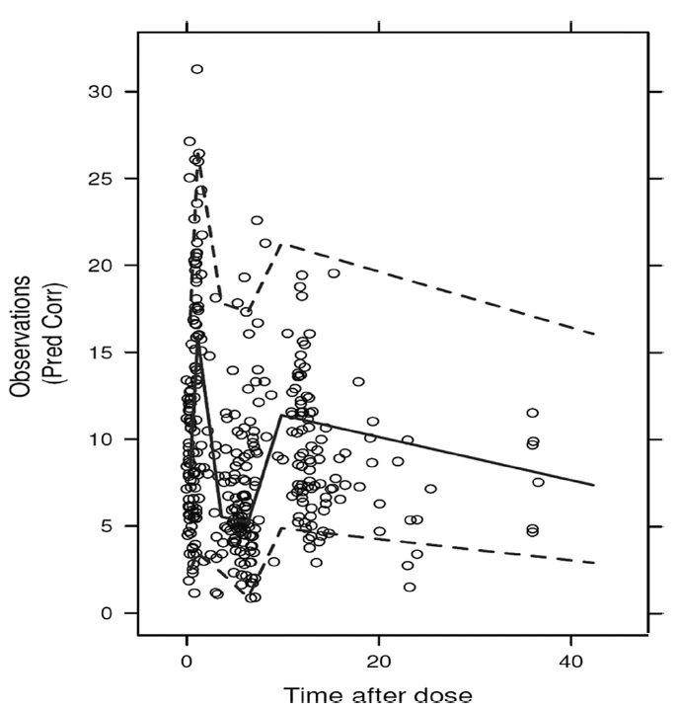
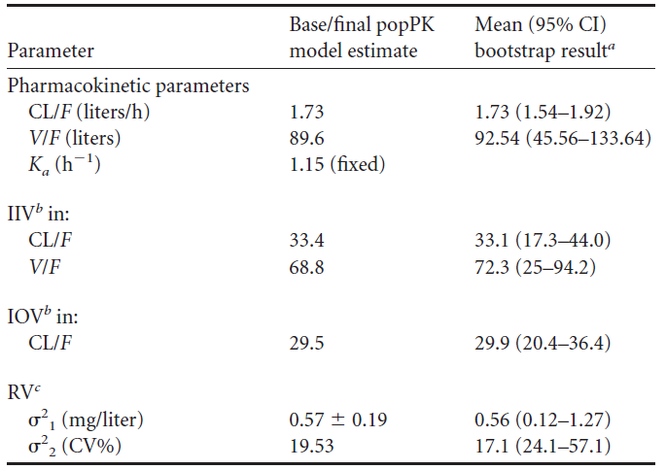
Benznidazole PK/PD parameters
Depot
K_{a}
Central
Dose
V
CL

Slide 10
Hands-on
Without treatment, what is the maximum number of amastigotes and when is this reached?

Slide 11

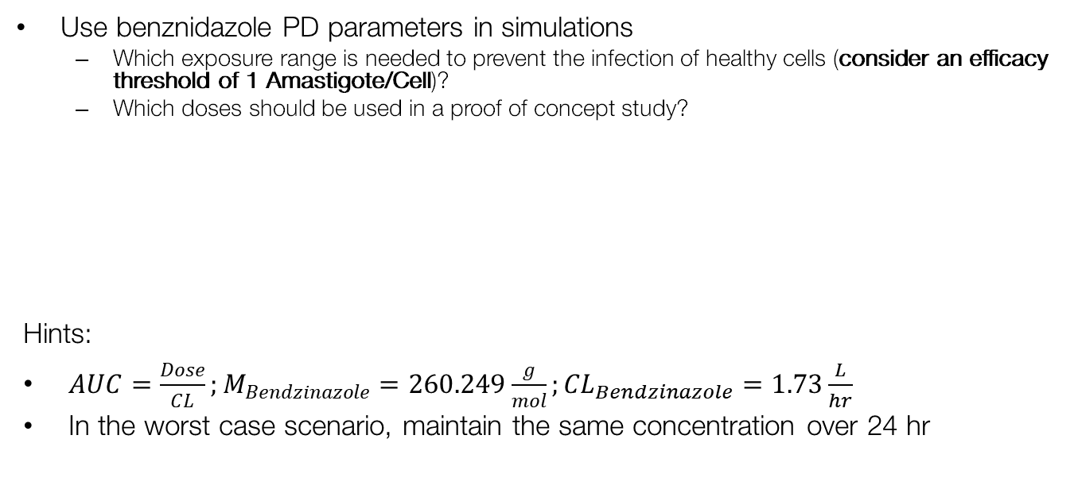
Hands-on
Use benznidazole PD parameters in simulations
Which exposure range is needed to prevent the infection of healthy cells (consider an efficacy threshold of 1 Amastigote/Cell)?
Which doses should be used in a proof of concept study?
Hints:
$AUC=\frac{Dose}{CL};M_{Bendzinazole}=260.249\frac{g}{mol};{CL}_{Bendzinazole}=1.73\frac{L}{hr}$
In the worst case scenario, maintain the same concentration over 24 hr
PD Parameter | Value
IC_{50K1} ($μM)$ | 4.26
EC_{50KDEATH} ($μM)$ | 14.73
E_{MAXKDEATH} | 77.10
IC_{50KOUT} ($μM)$ | 7.24

Slide 12
Hands-on
Use benznidazole human PK parameters in simulations
How does the efficacy in humans relate to the efficacy in-vitro?
Depot
K_{a}
Central
Dose
V
CL

Slide 13
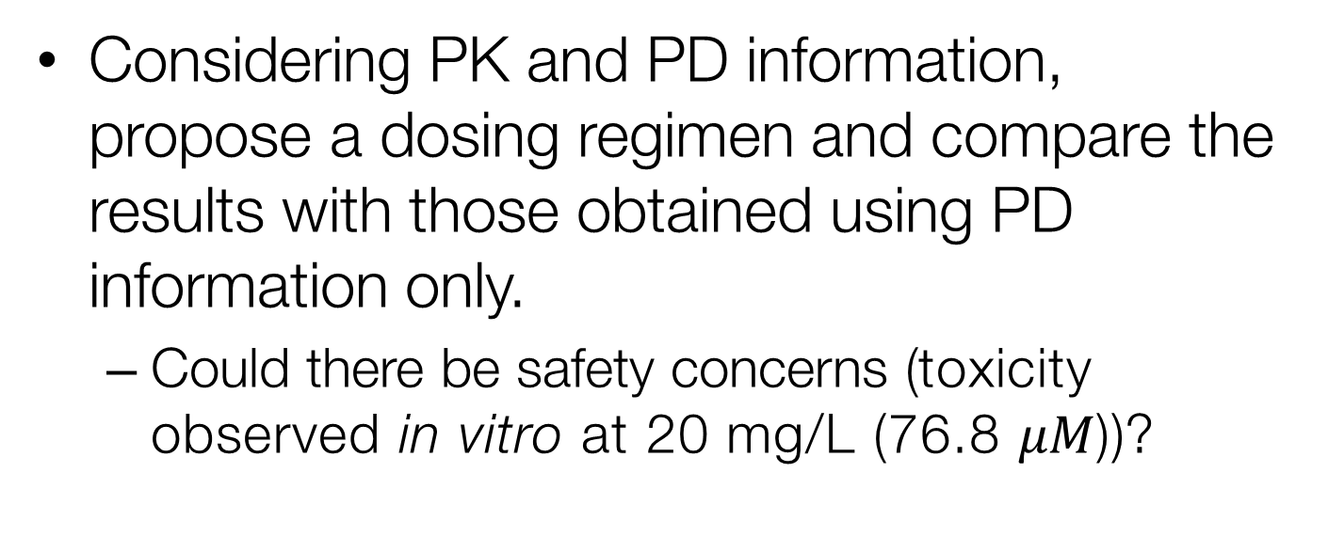
Hands-on
Considering PK and PD information, propose a dosing regimen and compare the results with those obtained using PD information only.
Could there be safety concerns (toxicity observed in vitro at 20 mg/L (76.8 $μM$))?

Slide 14
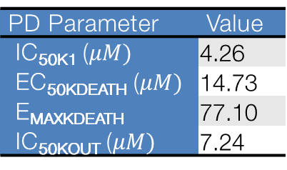
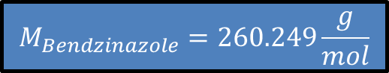
Useful figures
PD Parameter | Value
IC_{50K1} ($μM)$ | 4.26
EC_{50KDEATH} ($μM)$ | 14.73
E_{MAXKDEATH} | 77.10
IC_{50KOUT} ($μM)$ | 7.24
$$M_{Bendzinazole}=260.249\frac{g}{mol}$$

